Slide 1
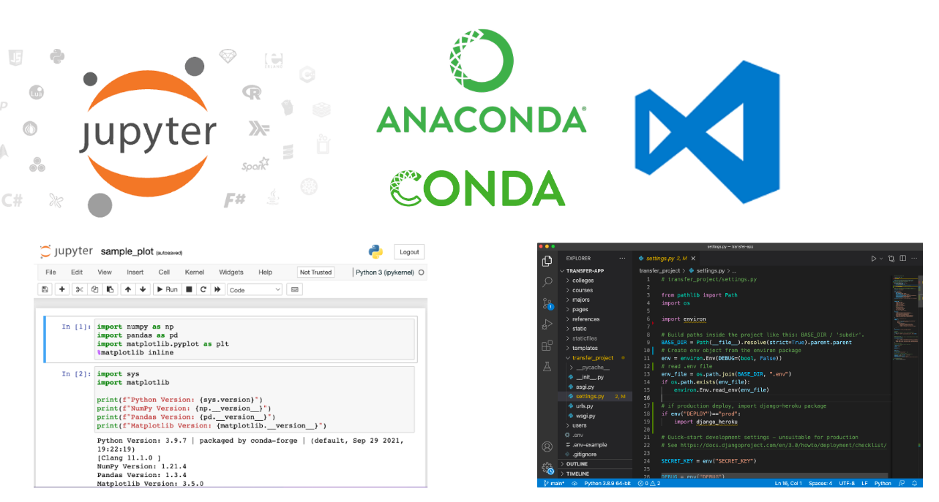
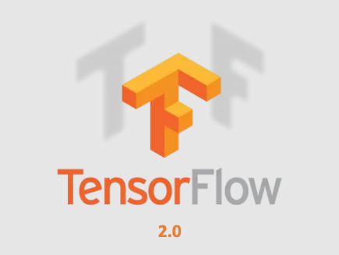

Environment Setup: Anaconda, Jupyter Notebook, Pandas, Scikit-Learn and Tensorflow 2.0 (Fall 2022 version)
Victor Chen

Slide 2
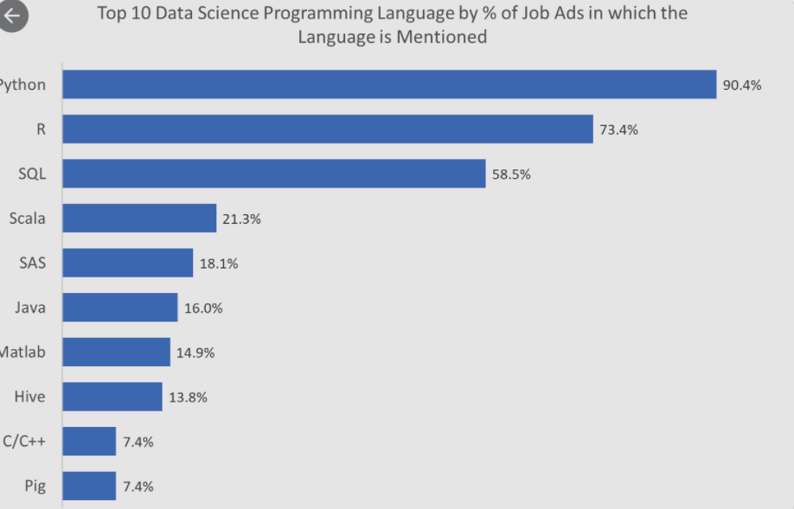
Python: # 1 language in data science

Slide 3
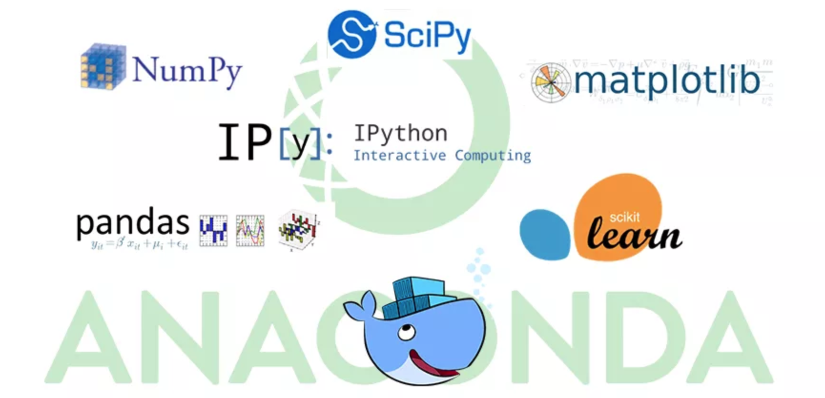
Anaconda (www.anaconda.com)

Slide 4
As of August 2022, the latest Anaconda Version is 2022.5 Please use ver. 2021.5 instead of 2022.5.
ver. 2021.5 = Python 3.8 while ver. 2022.5 = Python 3.9.
Python 3.9 now still has compatibility issues with a few AI libraries (such as gensim, a popular library for natural language processing).
Release notes:
https://docs.anaconda.com/anaconda/reference/release-notes/

Slide 5
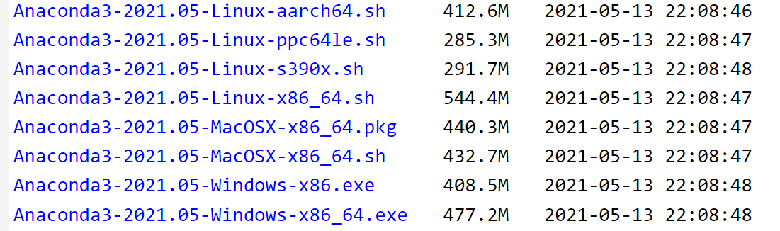
You can check the version of each library in each package here: https://docs.anaconda.com/anaconda/packages/oldpkglists/
Click the link to the Anaconda install archive:
https://repo.anaconda.com/archive/
Download the installer based on your platform (Use ver. 2021.05!) and install

Slide 6
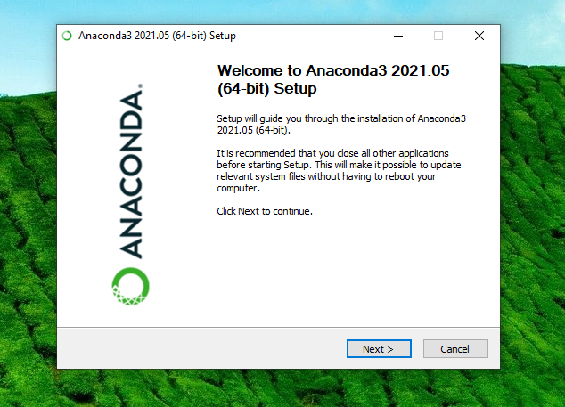
Installing..

Slide 7
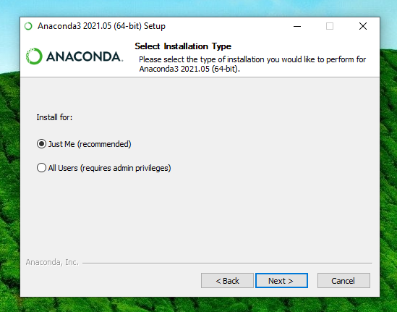
Installing..

Slide 8
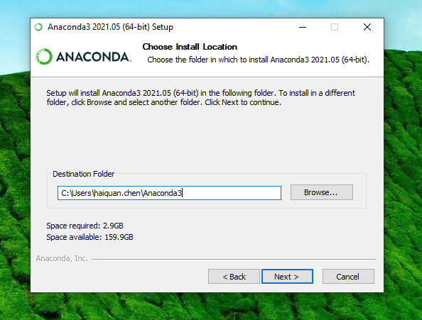
Installing..

Slide 9
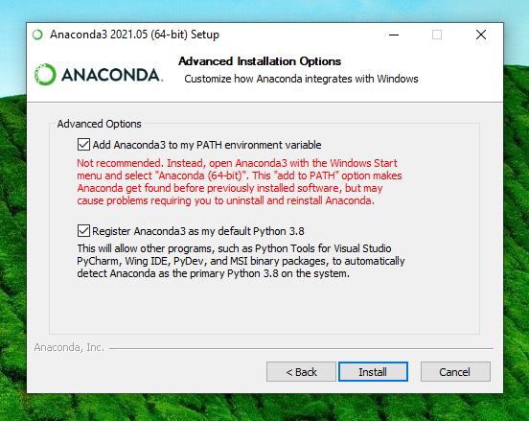
Important: Add anaconda to the PATH environment variable!

Slide 10
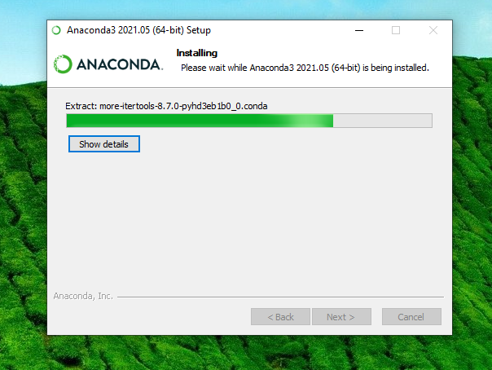
Installing.. (may take a few minutes)

Slide 11
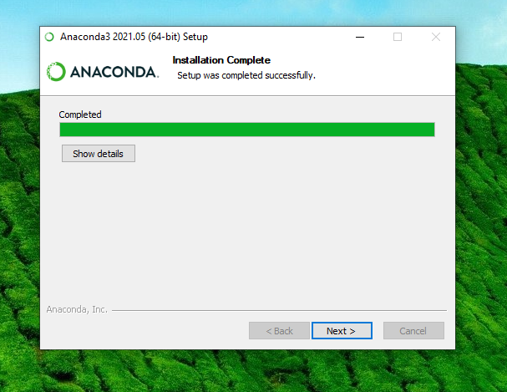
Finished

Slide 12
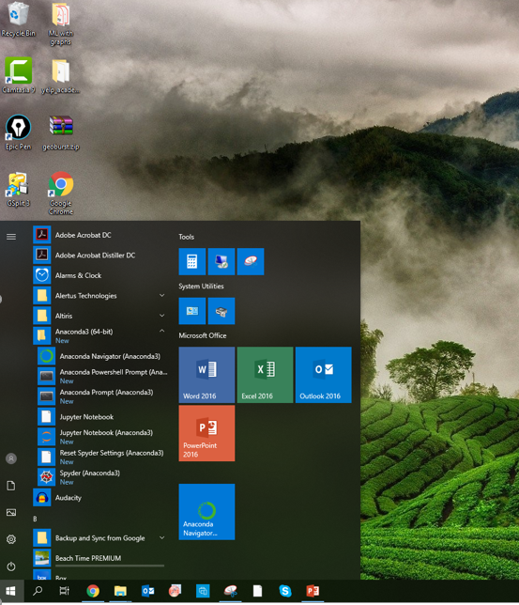
Launch navigator in start menu

Slide 13
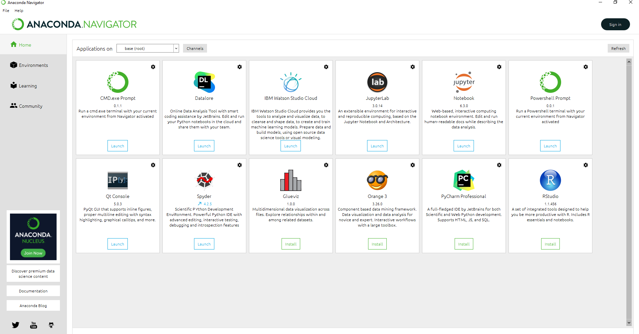
Launch navigator in start menu

Slide 14
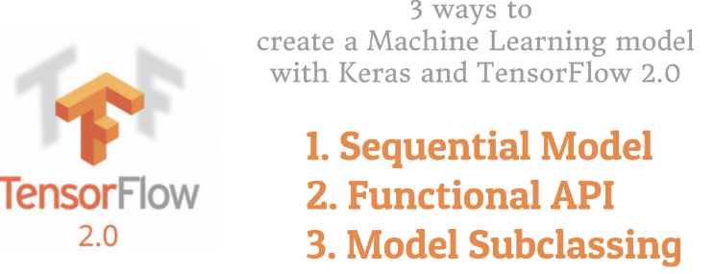
Install TensorFlow

Slide 15
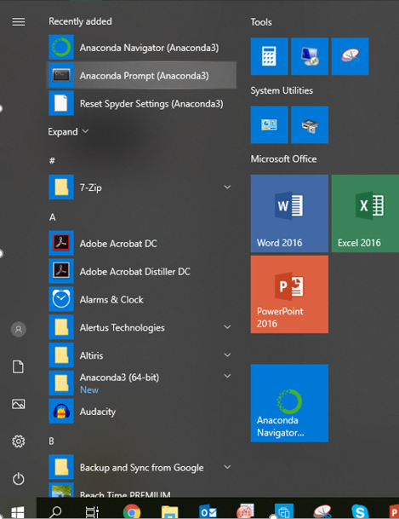
Install TensorFlow
https://www.anaconda.com/tensorflow-in-anaconda/
Go to Anaconda Prompt

Slide 16
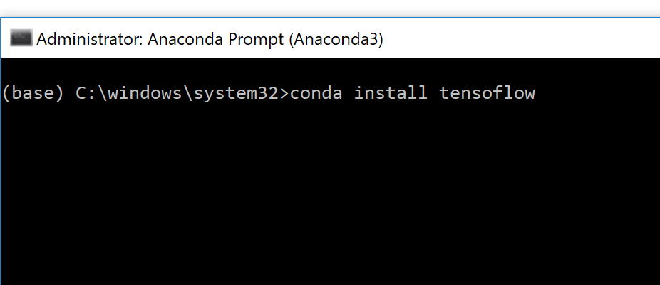
Install TensorFlow
Run “conda install tensorflow” or “conda install tensorflow-gpu” from the CLI (if you have NVIDIA GPU).
Many of the functions in TensorFlow can be accelerated using NVIDIA GPUs.
(optional) To verify GPU installation, check this link: here

Slide 17
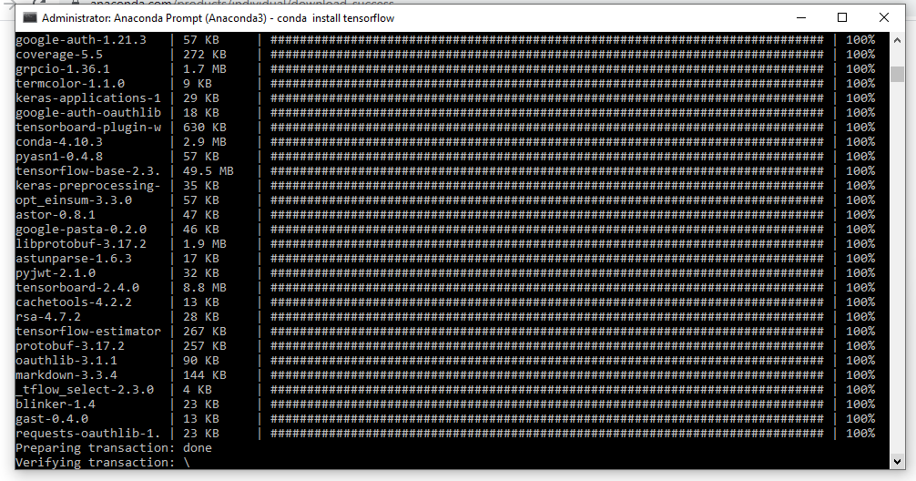
Install TensorFlow

Slide 18
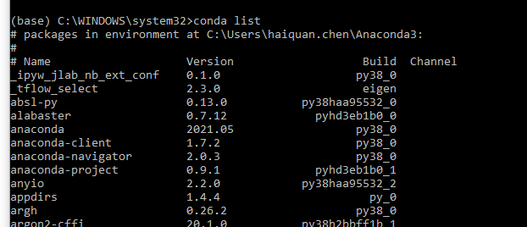
Know the libraries currently on your machine
Use “conda list” in Anaconda Prompt

Slide 19

Congratulations!

Slide 20
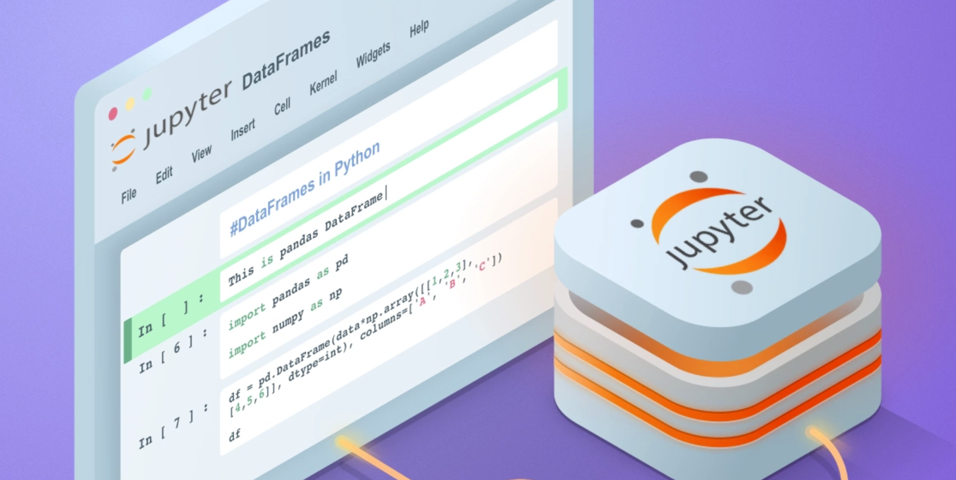
Jupyter notebook

Slide 21
What Is A Jupyter Notebook
A document which allows you to mix live code, math equations, text, plots, visualizations, audio, and video together in one place.
Jupyter notebooks provide interactive Python shell for you to run Python code.
Files with extension .ipynb
Great for data analysis, visualization, and sharing code among people.

Slide 22
Jupyter notebook has two types of cells
Code cell: where you write your Python code to run
Markdown cell: where you insert text/image/figure/audio/video

Slide 23
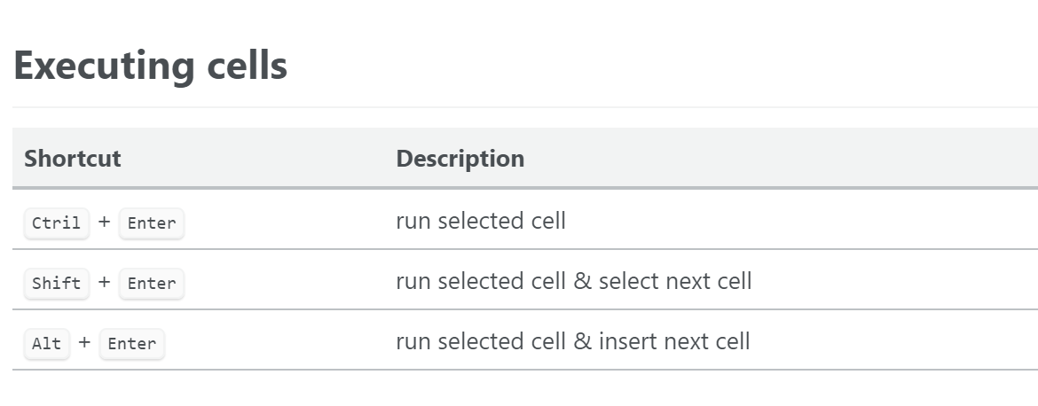
How to run each cell?

Slide 24
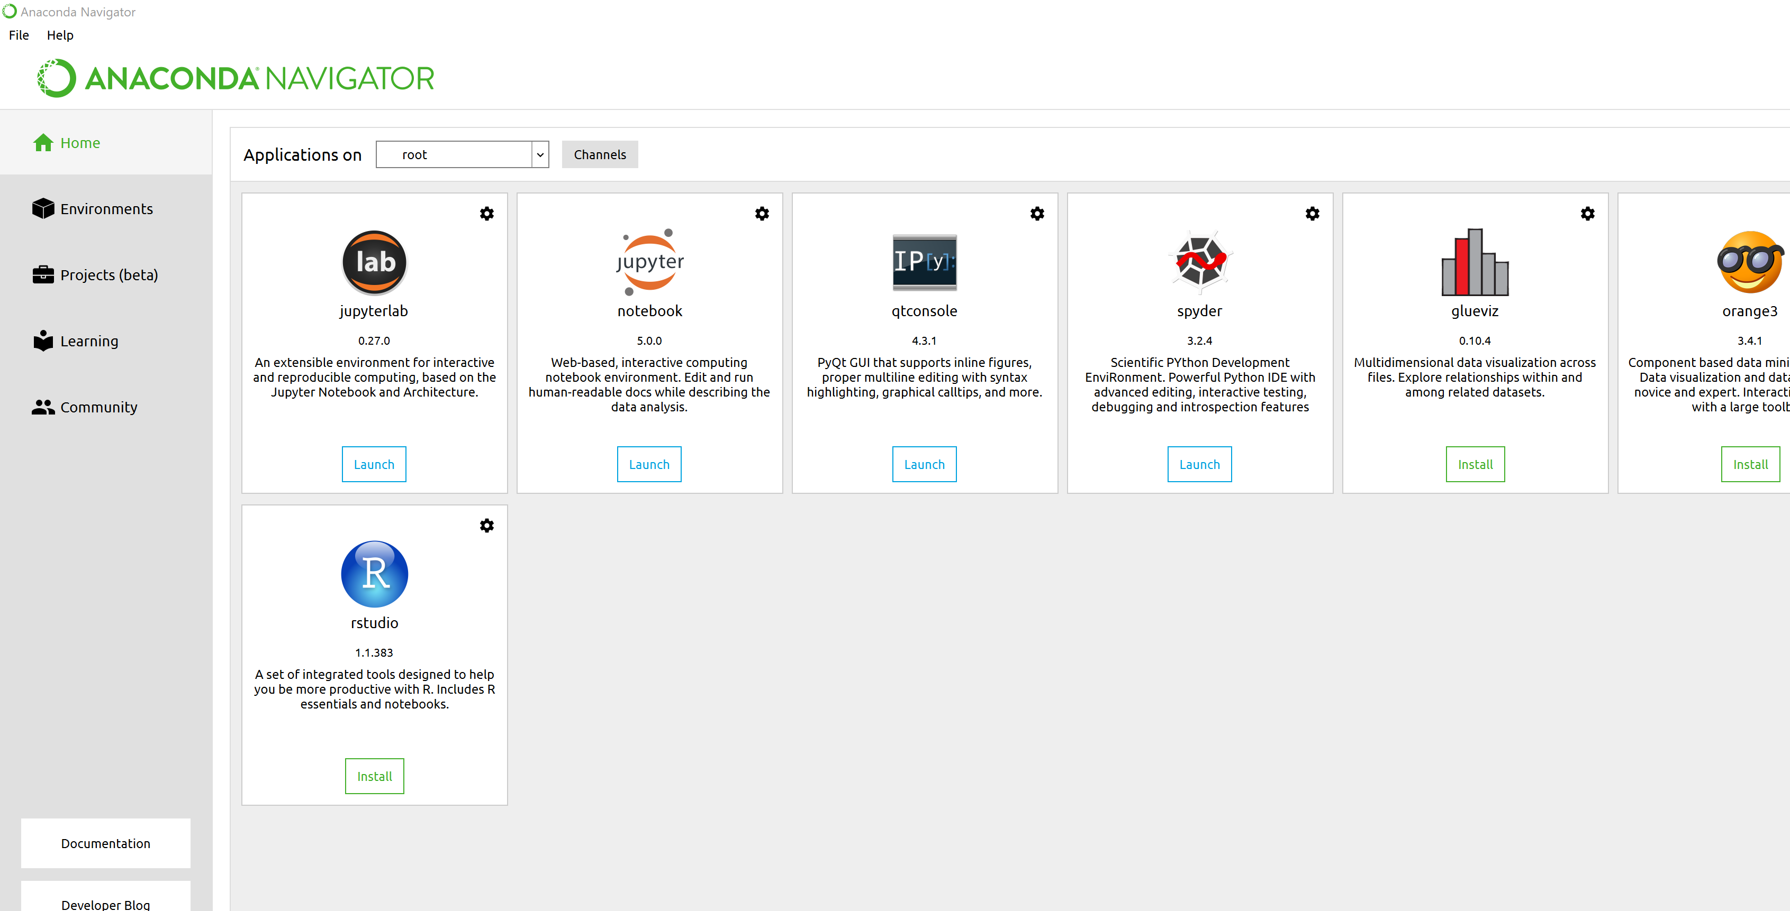
Jupyter notebook comes with Anaconda

Slide 25
How to open Jupyter notebooks (option 1)
Launch navigator in start menu
Launch Jupyter

Slide 26
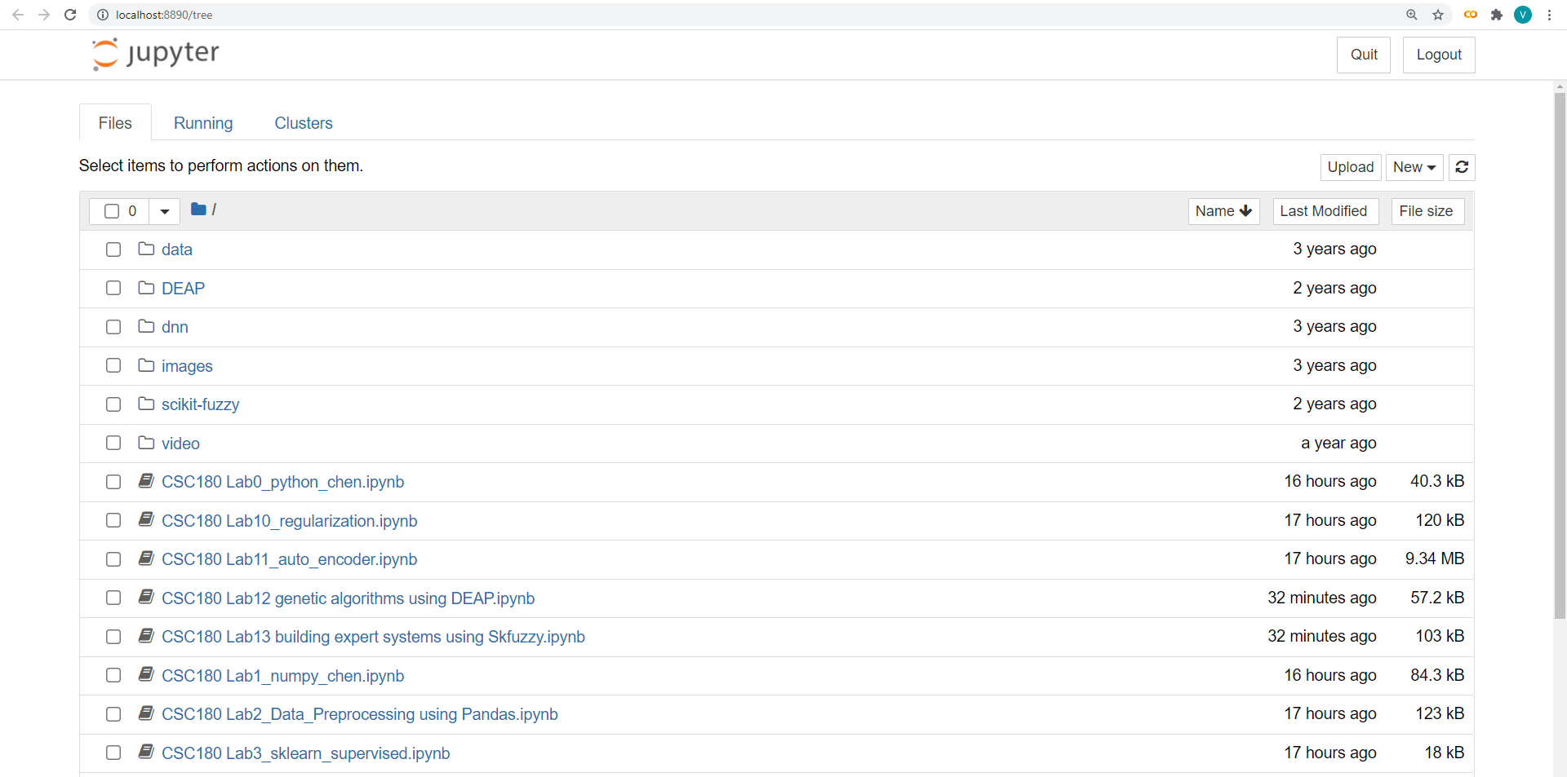
Then you'll see the application running in the web browser on the address: http://localhost:8888.

Slide 27
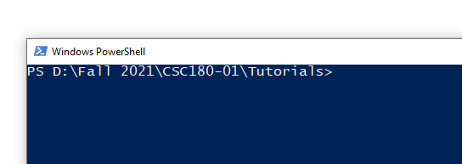
How To Open Jupyter Notebooks (option 2: preferred)
Go to the folder where your notebook is.
Open CLI
E.g., on Windows, shift + right click, then select “open Powershell window”
Run the following command to open up the application:
jupyter notebook

Slide 28
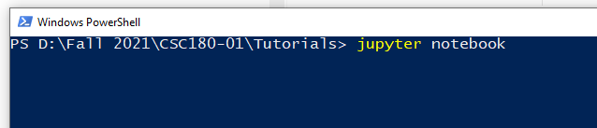
Run this command:

Slide 29
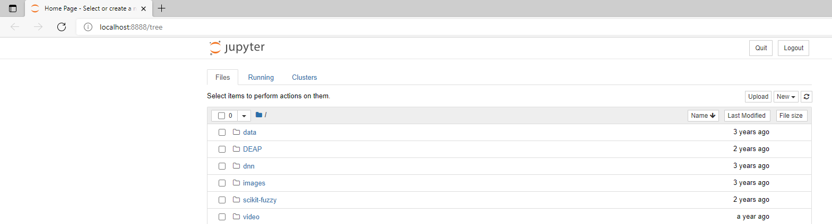
Then you'll see the application running in the web browser on the address: http://localhost:8888.

Slide 30
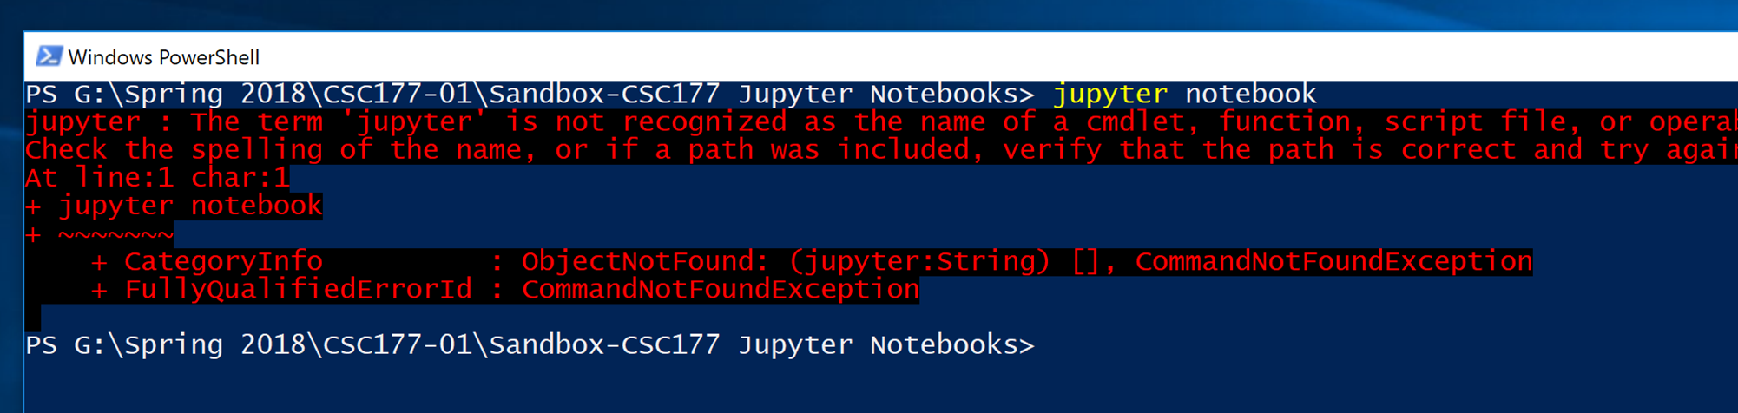
Troubleshooting: If you got this…

Slide 31
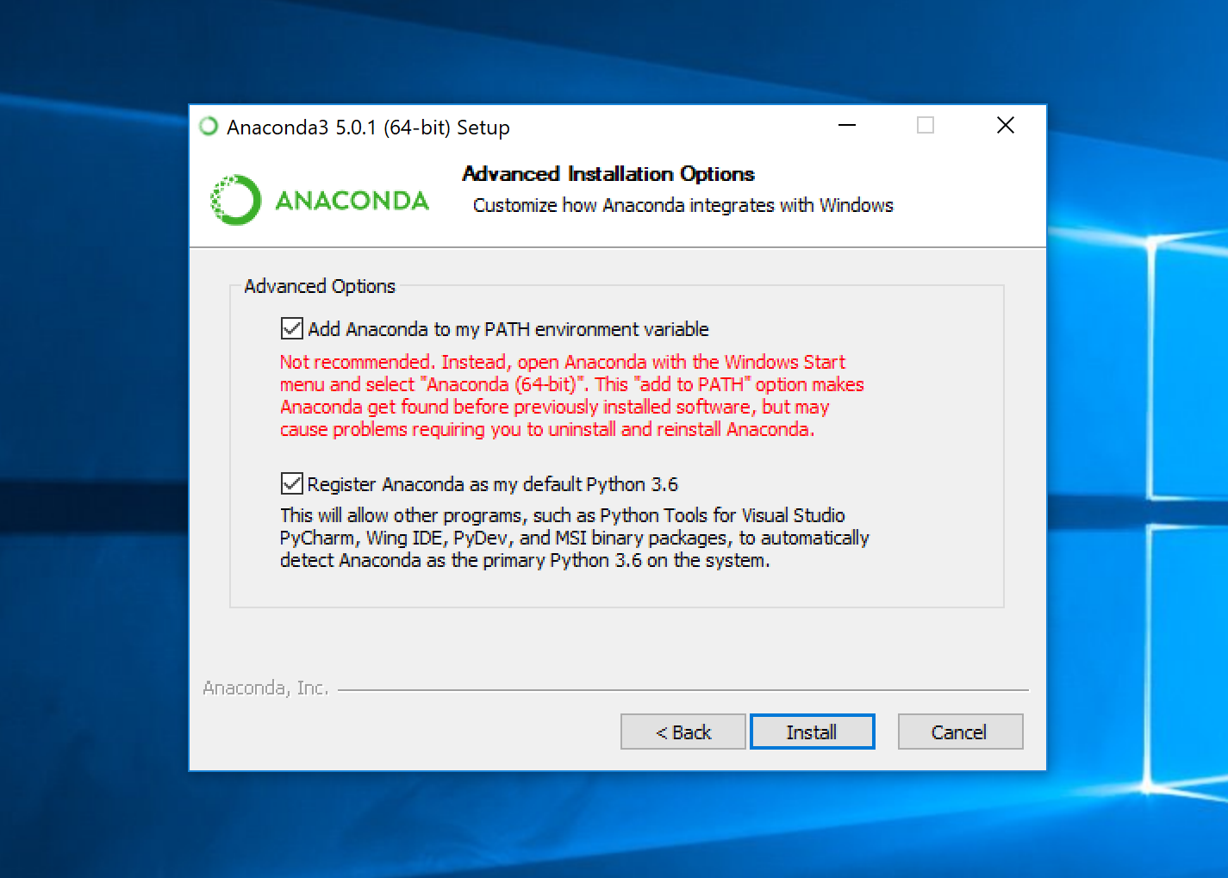
Make sure you added anaconda to PATH environment variable

Slide 32
Test your environment
Open (click) the notebook for Lab 0 in your browser

Slide 33
Test your environment (run this test code)
import tensorflow as tf
import sys
import sklearn as sk
import pandas as pd
print("Python {}".format(sys.version))
print('Pandas {}'.format(pd.__version__))
print('Scikit-Learn {}'.format(sk.__version__))
print()
print("Tensor Flow Version: {}".format(tf.__version__))
print("Keras Version: {}".format(tf.keras.__version__))

Slide 34
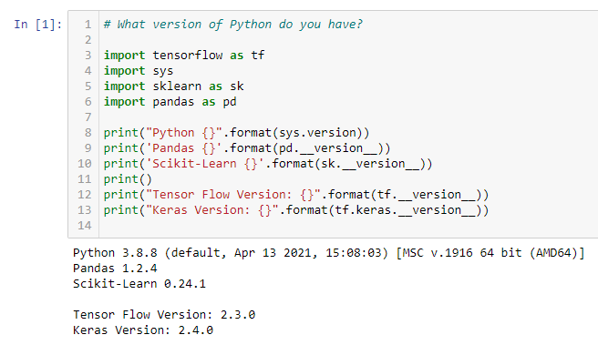
There are the environment parameters on my machine (I use Anaconda version 2021.05):

Slide 35
Note:
You can always go to Anaconda Prompt to launch a command line interface and type "conda list", which will return the exact version of each library that is currently on your machine.
If you need help with the installation, please let me know.

